Slide 1
University of Florida Online Dual Enrollment
Litza Echeverria Rubio, Ed.S.
Academic Program Manager
Distance & Continuing Education

Slide 2
ABOUT ONLINE DUAL ENROLLMENT
Eligible students gain access to UF courses delivered 100% online
Satisfy general education requirements and/or explore new subject areas through challenging electives
Take up to two courses each fall and spring semester at no cost
UF Dual Enrollment credits can be combined with other college credit opportunities to get you even further ahead

Slide 3
Eligibility criteria
Junior or Senior standing
3.6 cumulative unweighted GPA
Qualifying test scores
SAT: 1100
PSAT: 1130 (PSAT 10/NMSQT only)
ACT: 22

Slide 4
Applying to UF Dual Enrollment
Express interest to school counselor
Submit an application on our website
Opened February 7th, 2022
Closes April 15th, 2022
Stay connected to email for continued communication

Slide 5
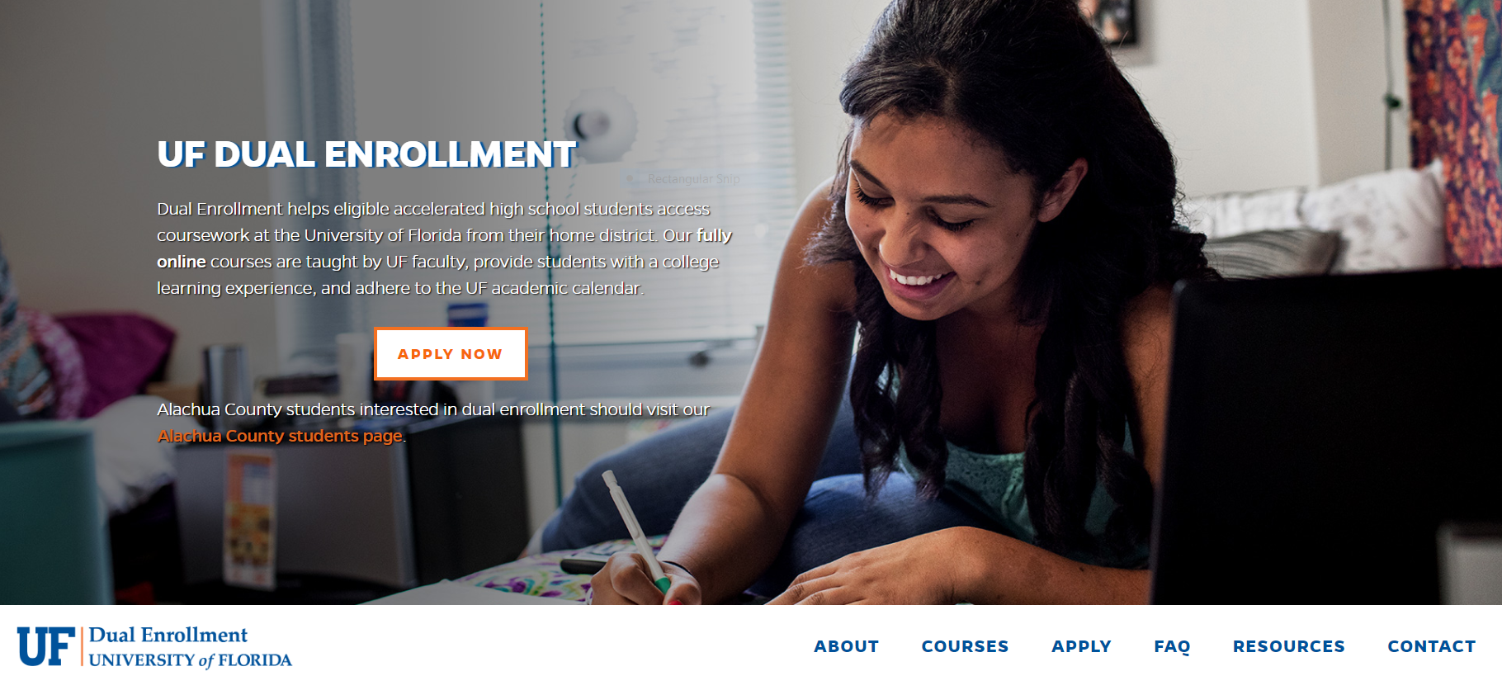
dualenrollment.dce.ufl.edu

Slide 6
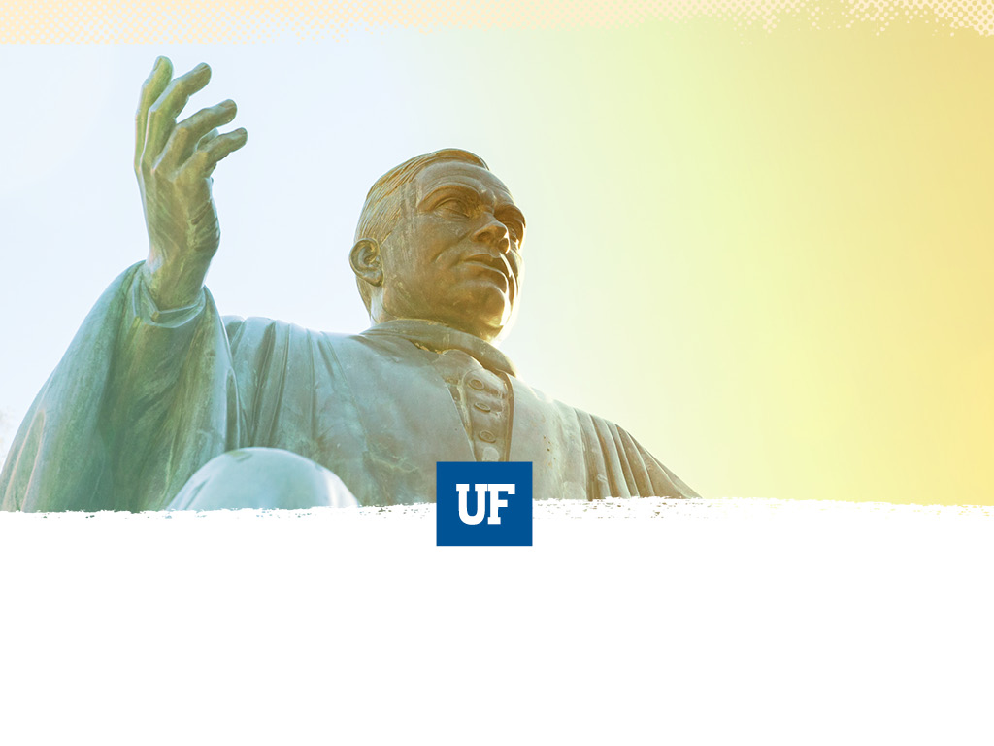
OUR COURSES
Vary term to term
Cover a wide range of subject areas
Provide a rigorous collegiate experience
No easy A’s

Slide 7
ADVISING
Before registration:
Application
Course Selection
Enrollment
Textbook Arrangements
After registration:
Semester Check-ins
Any time by phone or e-mail!

Slide 8
Questions?
Litza Echeverria Rubio, Ed.S.
Academic Program Manager
Distance & Continuing Education
University of Florida
Dual-enrollment@dce.ufl.edu
352-273-4155
Allison Costa
Academic Program Coordinator
Distance & Continuing Education
University of Florida
Dual-enrollment@dce.ufl.edu
352-273-4155
Notes:
Also in Counselor Guide
Ability to do virtual presentations

